Slide 1
JAVA 11
New features

Slide 2
Upgrading from java 8 sounds scary

Slide 3
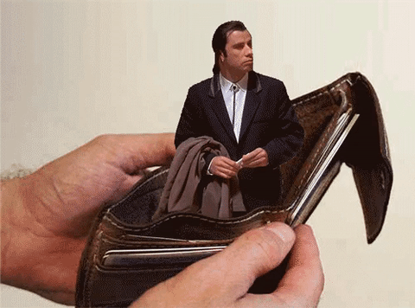
Upgrading from java 8 sounds scary
I don’t want to pay for java

Slide 4

Upgrading from java 8 sounds scary
Super happy with java 8, thanks

Slide 5
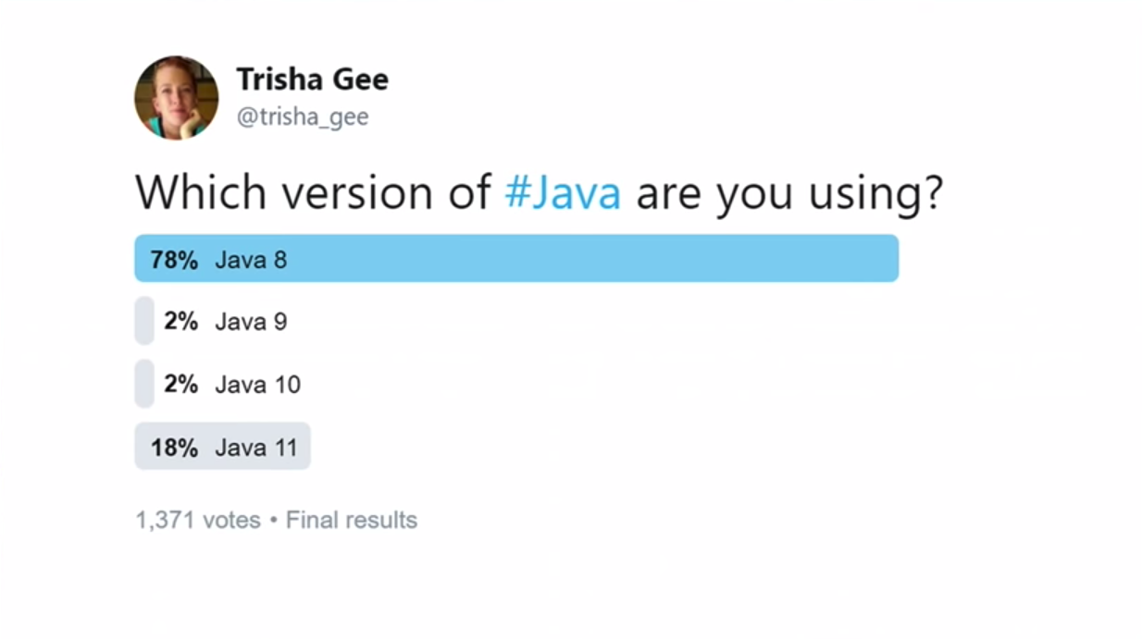
Upgrading from java 8 sounds scary

Slide 6
Releases, Updates, licensing & support

Slide 7
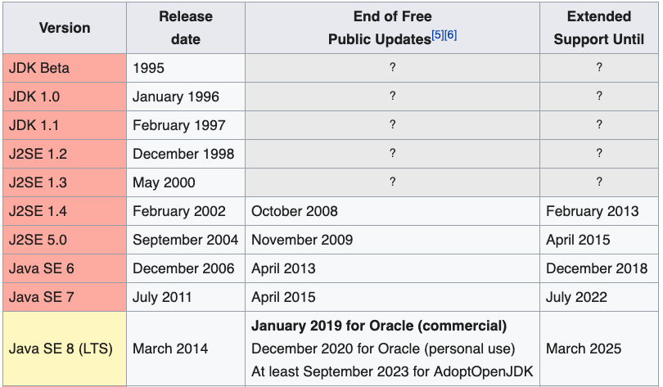
Releases
Before JAVA 9 the Versions were released every two/three years

Slide 8
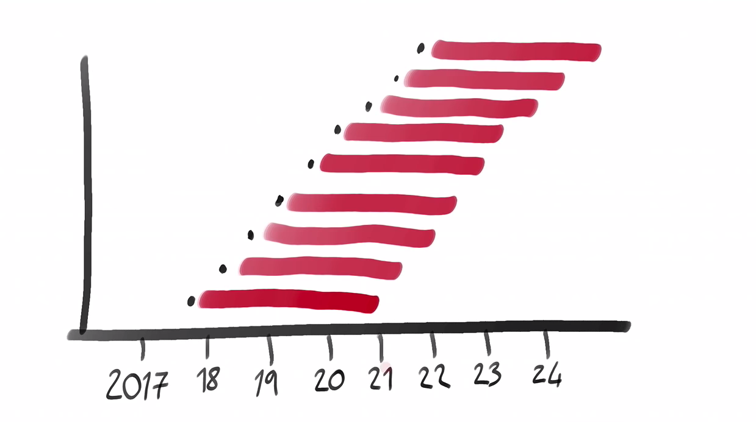
Releases

Slide 9
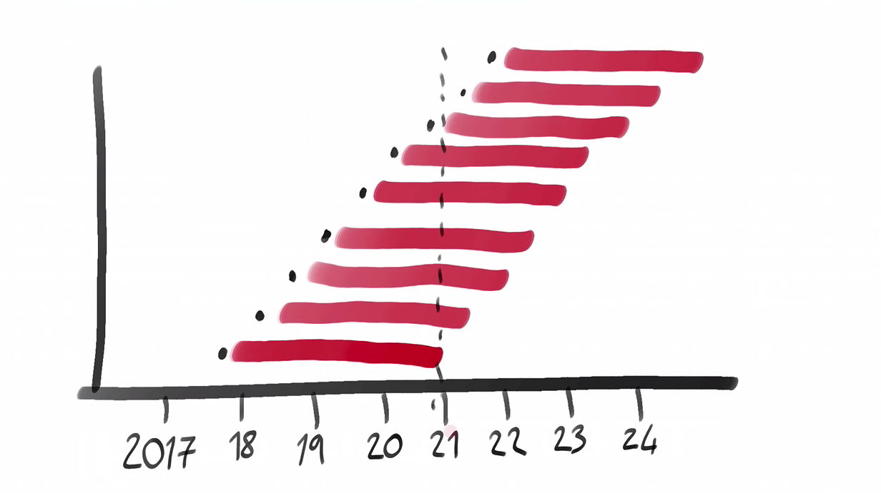
Releases

Slide 10
Releases
Releses of JAVA every six months

Slide 11
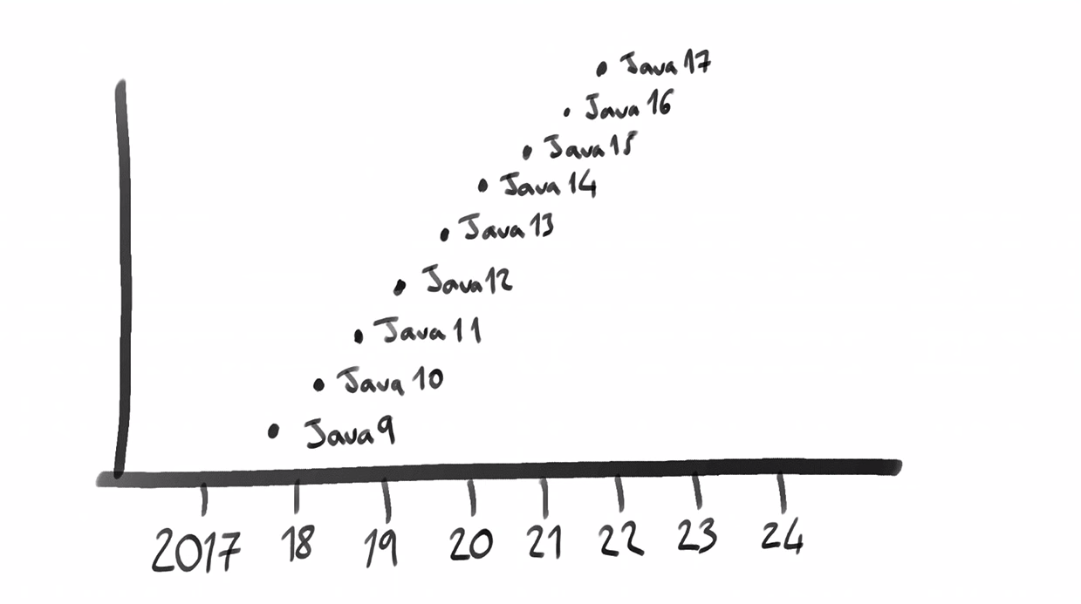
Releases
Notes:
Features releases for every 6 moths Updateded releases

Slide 12
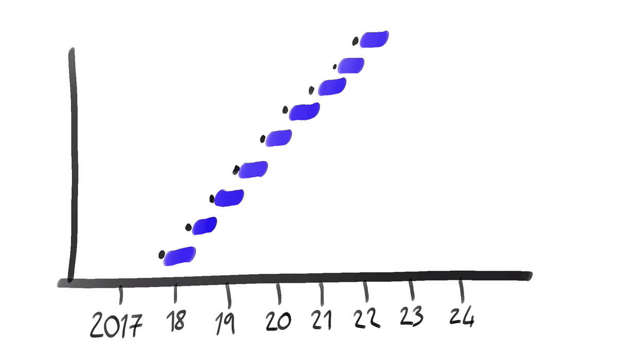
Releases

Slide 13
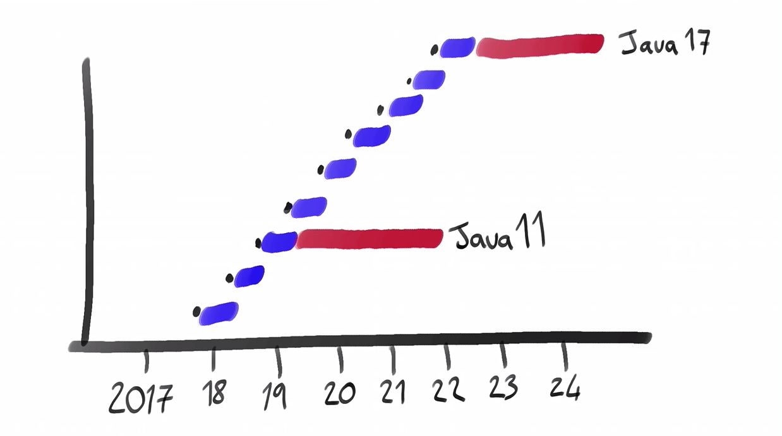
Releases

Slide 14
So now we have tow types of releases
Interim releases
LTS (Long term support) releases

Slide 15
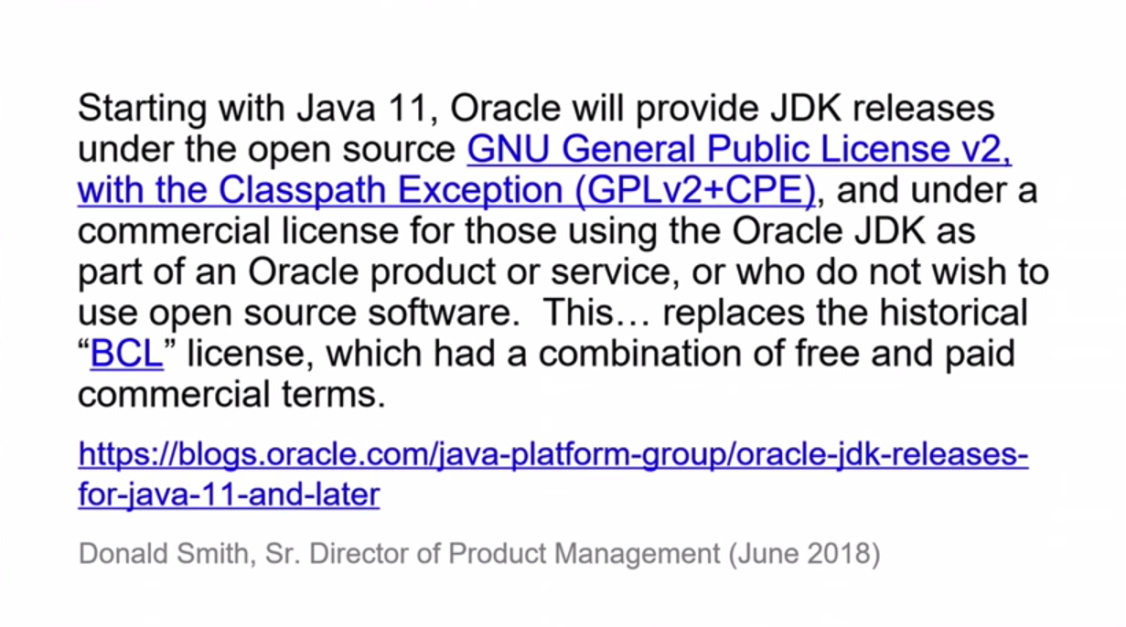
Licensing

Slide 16

That sounds overly complicated. Talk us through it.

Slide 17
licensing
Commercial oracle JDK
OpenJDK

Slide 18

Why two?

Slide 19
licensing
Oracle OpenJDK is $free
But will be replaced every 6 months
Oracle Commercial JDK has LTS
But you have to pay to use it in production

Slide 20
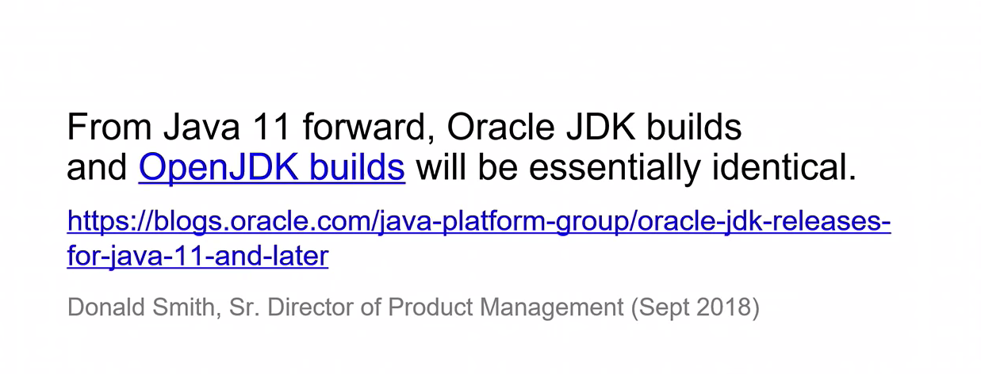
licensing

Slide 21
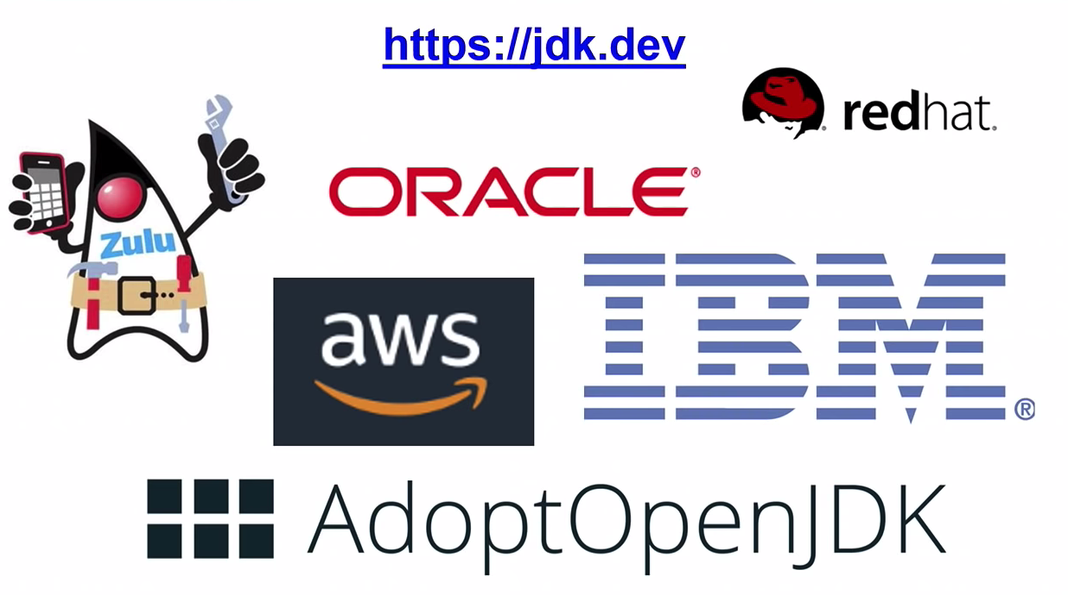
Licensing
OpenJDK

Slide 22

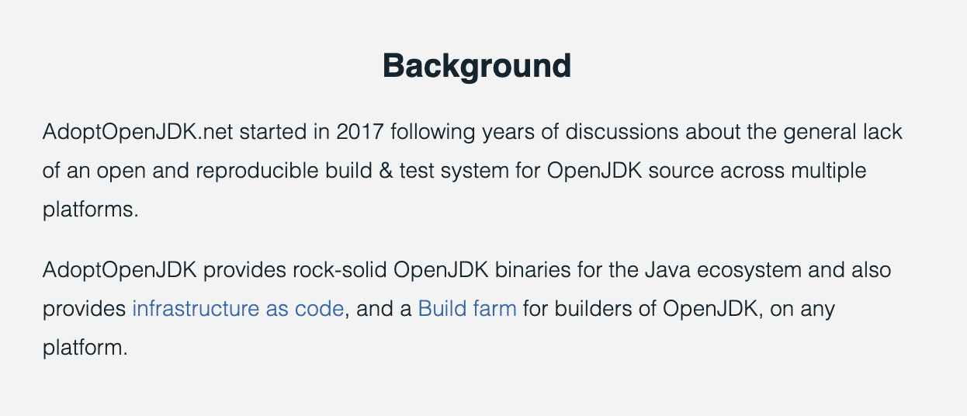
Licensing
https://adoptopenjdk.net/about.html

Slide 23
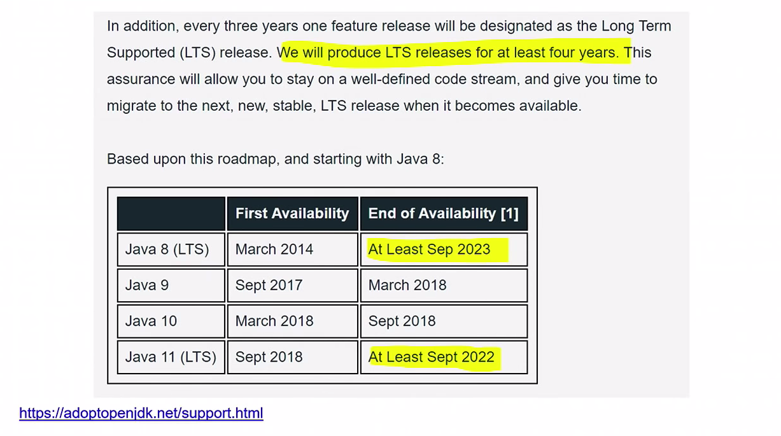
Licensing

Slide 24

Show me why I should start using java 11
Show me the code

Slide 25
New Features
Jshel
VAR
Collection factories
list.of
Map.of
Stream
Optional
Multi release jar Files
Switch expressions

Slide 26

The business doesn’t care about language features

Slide 27
performance
Memory Usage
Garbage collector improvements

Slide 28
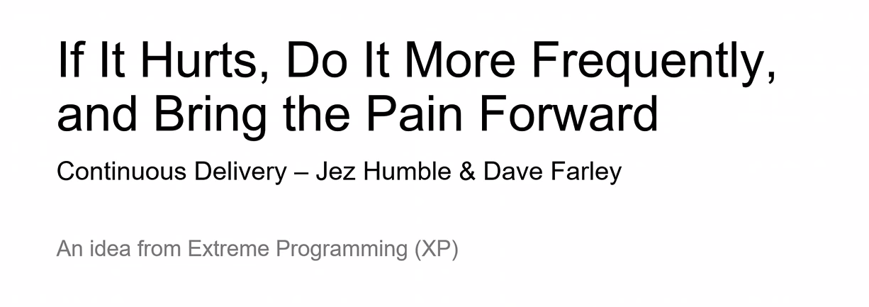
pain

